Slide 1


Chapter
7
Hypothesis Testing with One Sample

Slide 2
Chapter Outline
7.1 Introduction to Hypothesis Testing
7.2 Hypothesis Testing for the Mean (σ Known)
7.3 Hypothesis Testing for the Mean (σ Unknown)
7.4 Hypothesis Testing for Proportions
7.5 Hypothesis Testing for Variance and Standard
Deviation
.

Slide 3
Section 7.4
Hypothesis Testing for Proportions
.

Slide 4
Section 7.4 Objectives
How to use the z-test to test a population proportion p
.

Slide 5

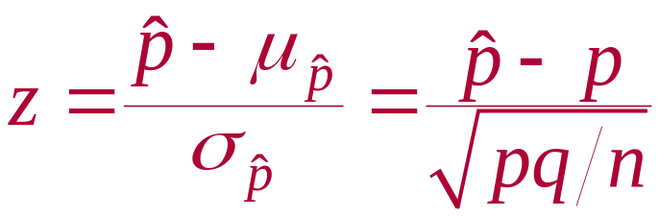
z-Test for a Population Proportion
z-Test for a Population Proportion
A statistical test for a population proportion.
Can be used when a binomial distribution is given such that np ≥ 5 and nq ≥ 5.
The test statistic is the sample proportion .
The standardized test statistic is z.
.

Slide 6

Using a z-Test for a Proportion p
In Words In Symbols
Verify that the sampling distribution of can be approximated by the normal distribution.
State the claim mathematically and verbally. Identify the null and alternative hypotheses.
Specify the level of significance.
Determine any critical value(s).
np ≥ 5 and nq ≥ 5
State H₀ and H_{a}.
Identify α.
Use Table 5 in Appendix B.
.

Slide 7
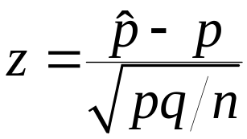
Using a z-Test for a Proportion p
In Words In Symbols
Determine the rejection region(s).
Find the standardized test statistic and sketch the sampling distribution.
Make a decision to reject or fail to reject the null hypothesis.
Interpret the decision in the context of the original claim.
If z is in the rejection region, reject H₀. Otherwise, fail to reject H₀.
.

Slide 8
Example: Hypothesis Test for a Proportion
A research center claims that less than 50% of U.S. adults have accessed the Internet over a wireless network with a laptop computer. In a random sample of 100 adults, 39% say they have accessed the Internet over a wireless network with a laptop computer. At α = 0.01, is there enough evidence to support the researcher’s claim? (Adopted from Pew Research Center)
Solution:
Verify that np ≥ 5 and nq ≥ 5.
np = 100(0.50) = 50 and nq = 100(0.50) = 50
.

Slide 9
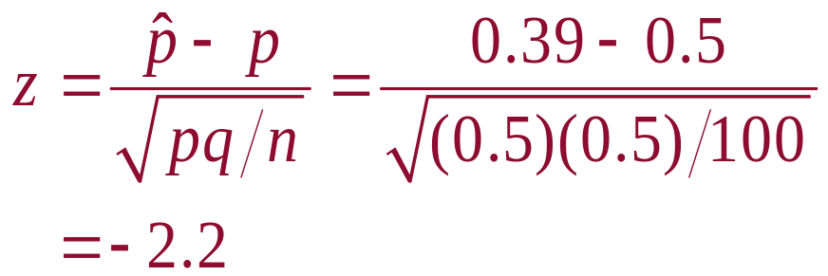
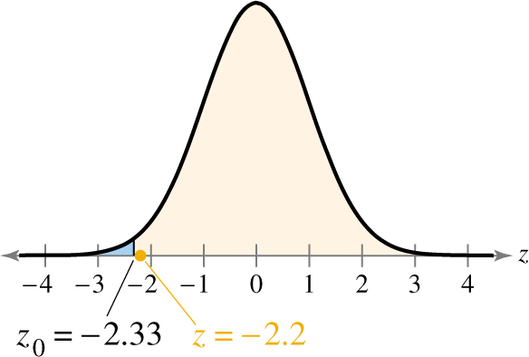
Solution: Hypothesis Test for a Proportion
Test Statistic
H₀:
H_{a}:
α =
Rejection Region:
p ≥ 0.5
p < 0.5
0.01
Decision:
Fail to reject H₀
At the 1% level of significance, there is not enough evidence to support the claim that less than 50% of U.S. adults have accessed the Internet over a wireless network with a laptop computer.
.

Slide 10

Example: Hypothesis Test for a Proportion
The Research Center claims that 25% of college graduates think a college degree is not worth the cost. You decide to test this claim and ask a random sample of 200 college graduates whether they think a college is not worth the cost. Of those surveyed, 21% reply yes. At
α = 0.10 is there enough evidence to reject the claim?
Solution:
Verify that np ≥ 5 and nq ≥ 5.
np = 200(0.25) = 50 and nq = 200 (0.75) = 150
.

Slide 11
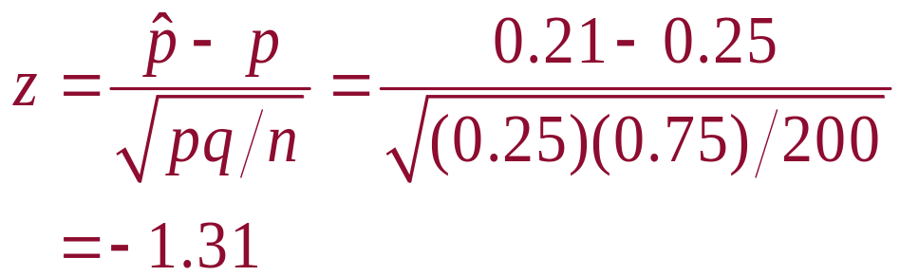
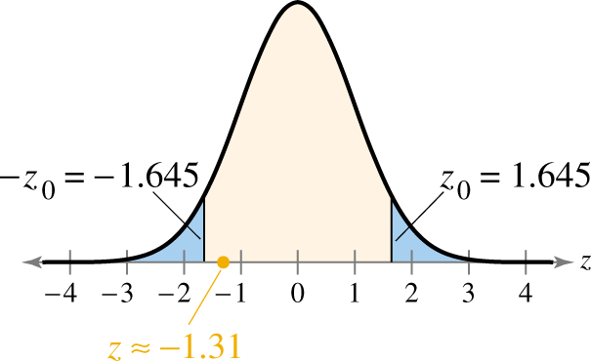
Solution: Hypothesis Test for Proportions
Test Statistic
H₀:
H_{a}:
α =
Rejection Region:
p = 0.25
p ≠ 0.25
0.10
Decision:
Fail to reject H₀
At the 10% level of significance, there is not enough evidence to reject the claim that 25% of college graduates think a college degree is not worth the cost.

Slide 12
Section 7.4 Summary
Used the z-test to test a population proportion p
.

